Slide 1
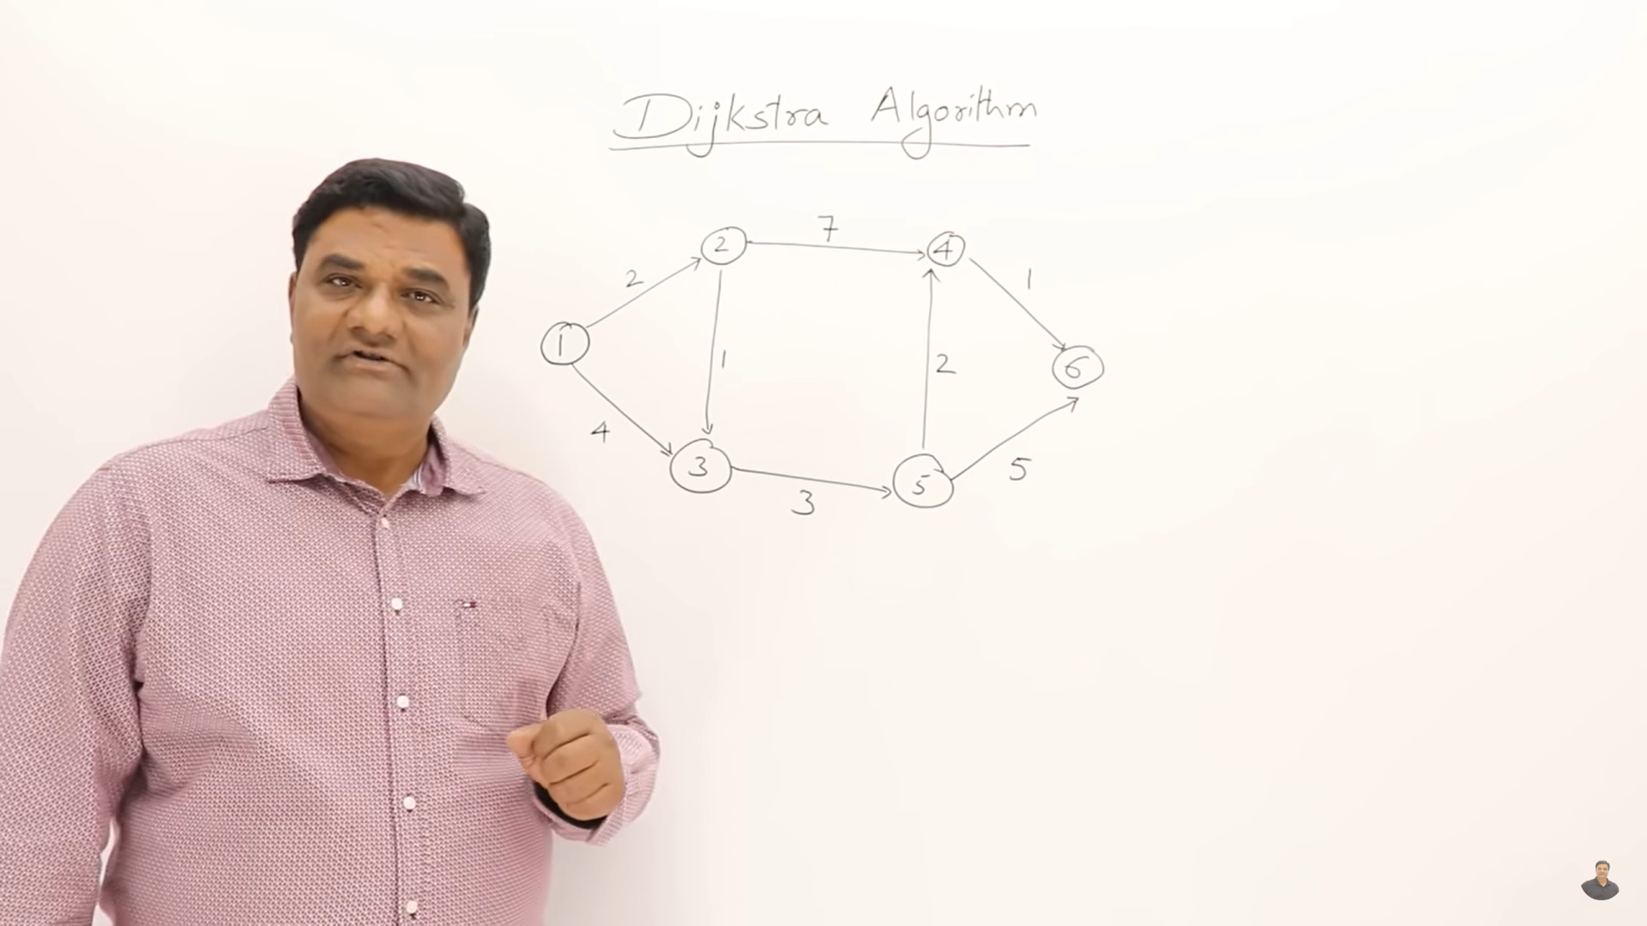

Slide 2
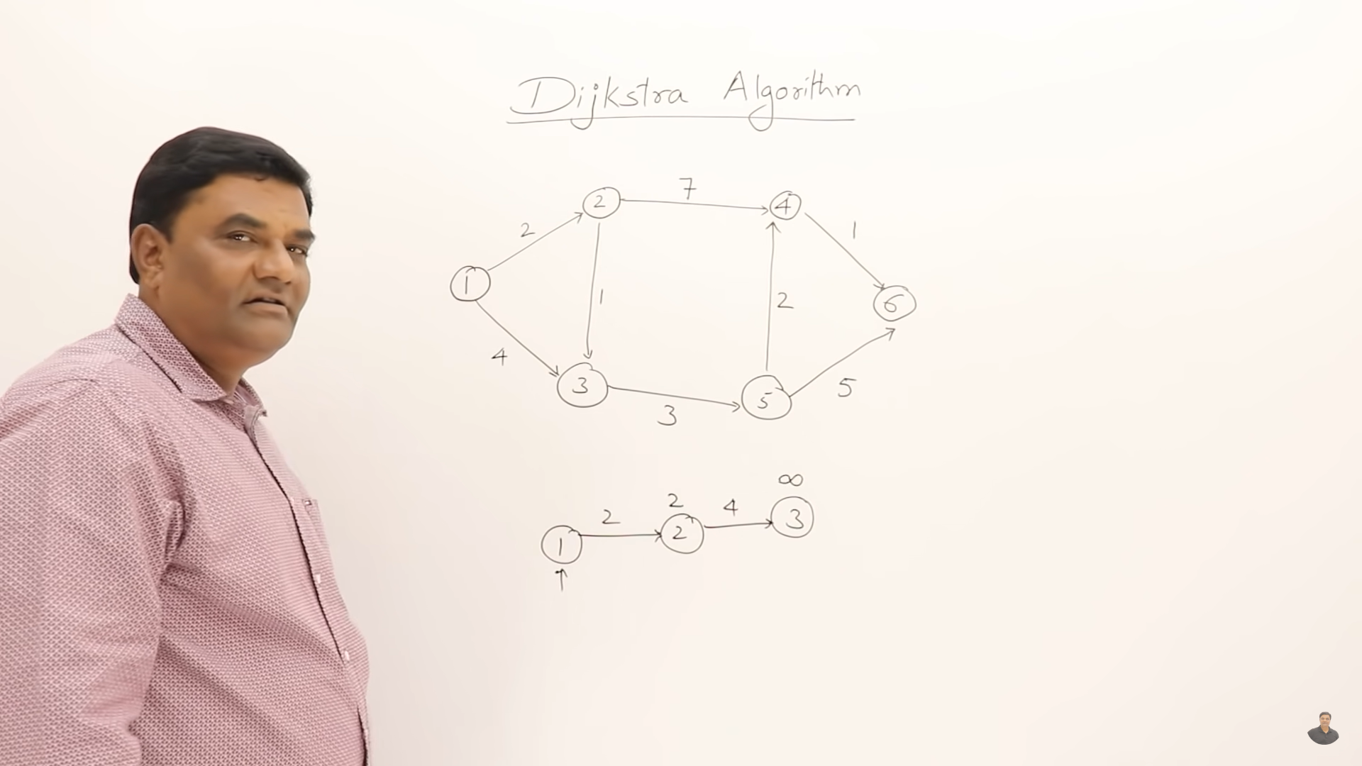
From 1-2 we now the cost is 2
From 1-4 we don’t know cost

Slide 3
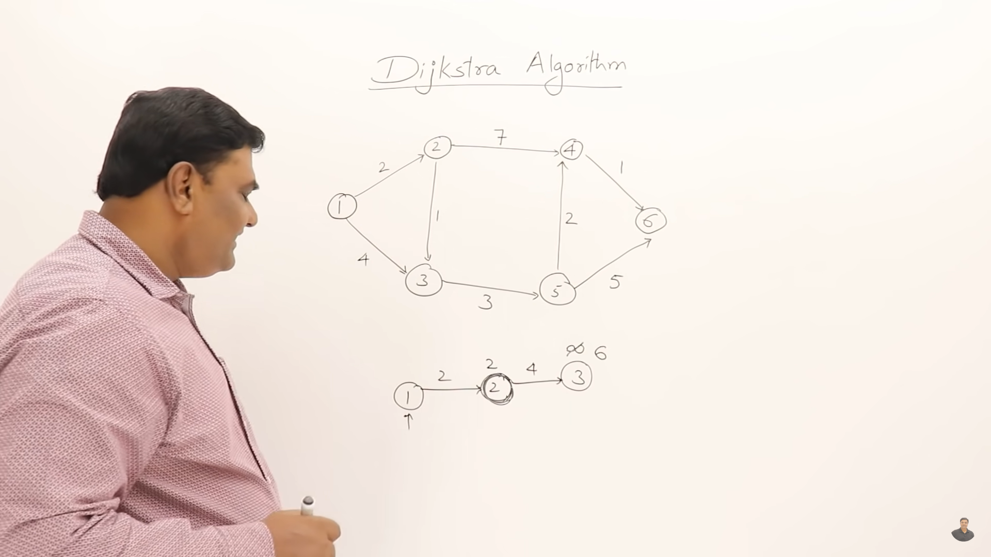

Slide 4
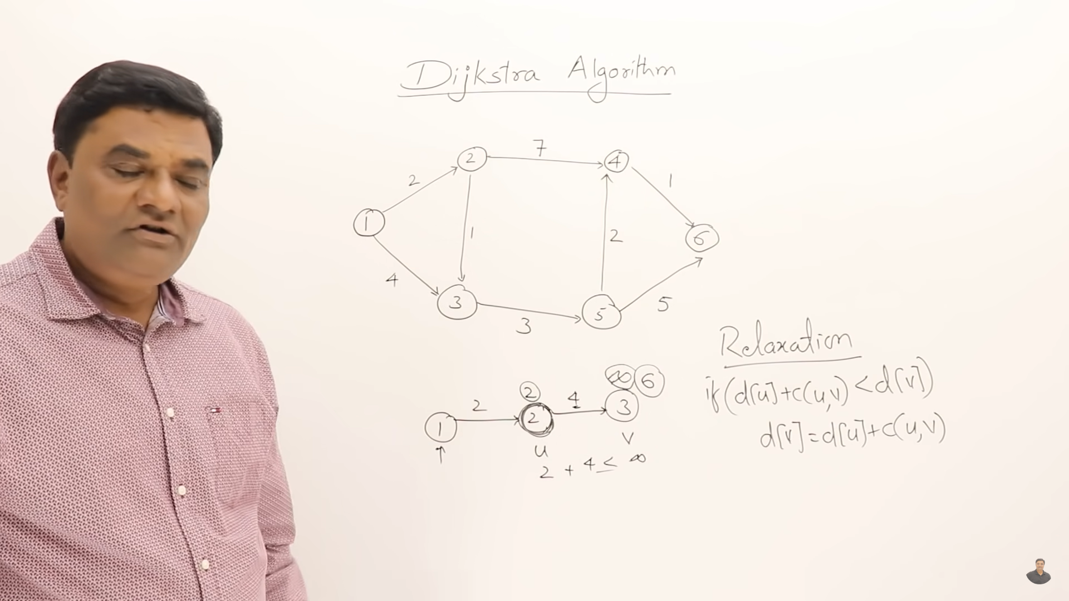
D:distance
C:cost

Slide 5
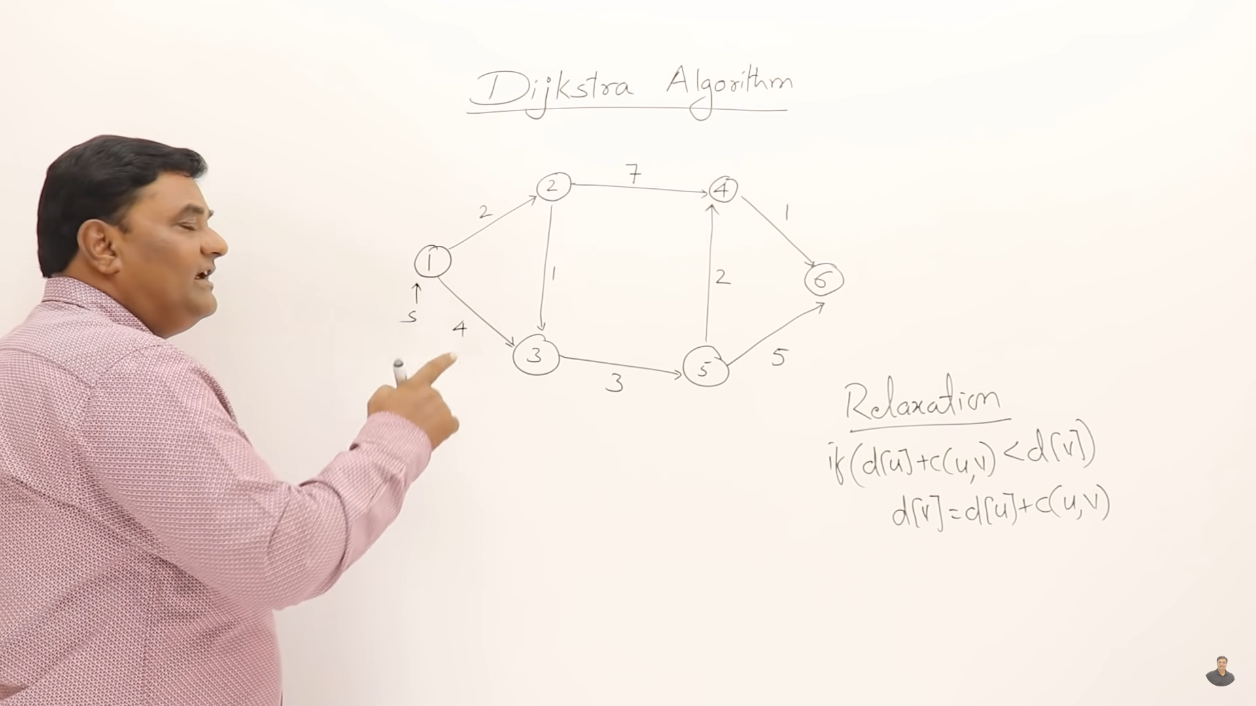
Start at v1

Slide 6
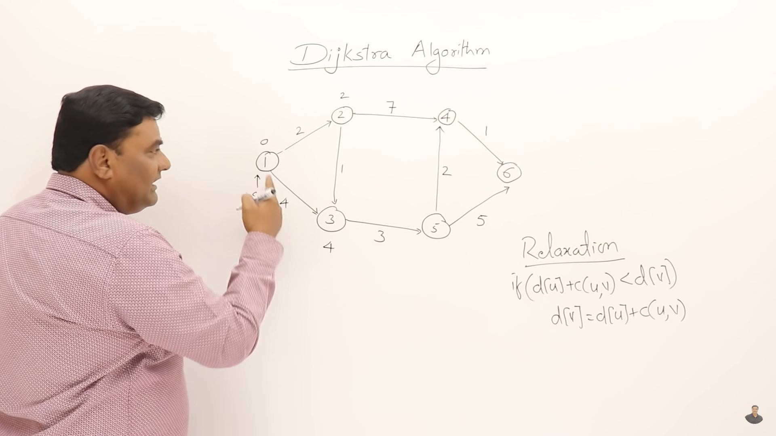
Distance 1-2 is 2
Distance itself is 0
Distance 1-3 is 4

Slide 7
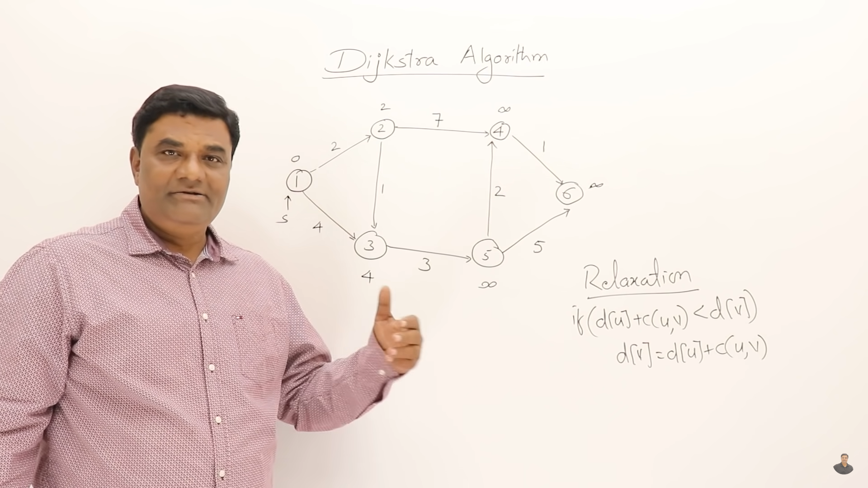
Distance 1-4 is inf cause we don’t know
Distance 1-6 is inf cause we don’t know
Distance 1-5 is inf cause we don’t know

Slide 8
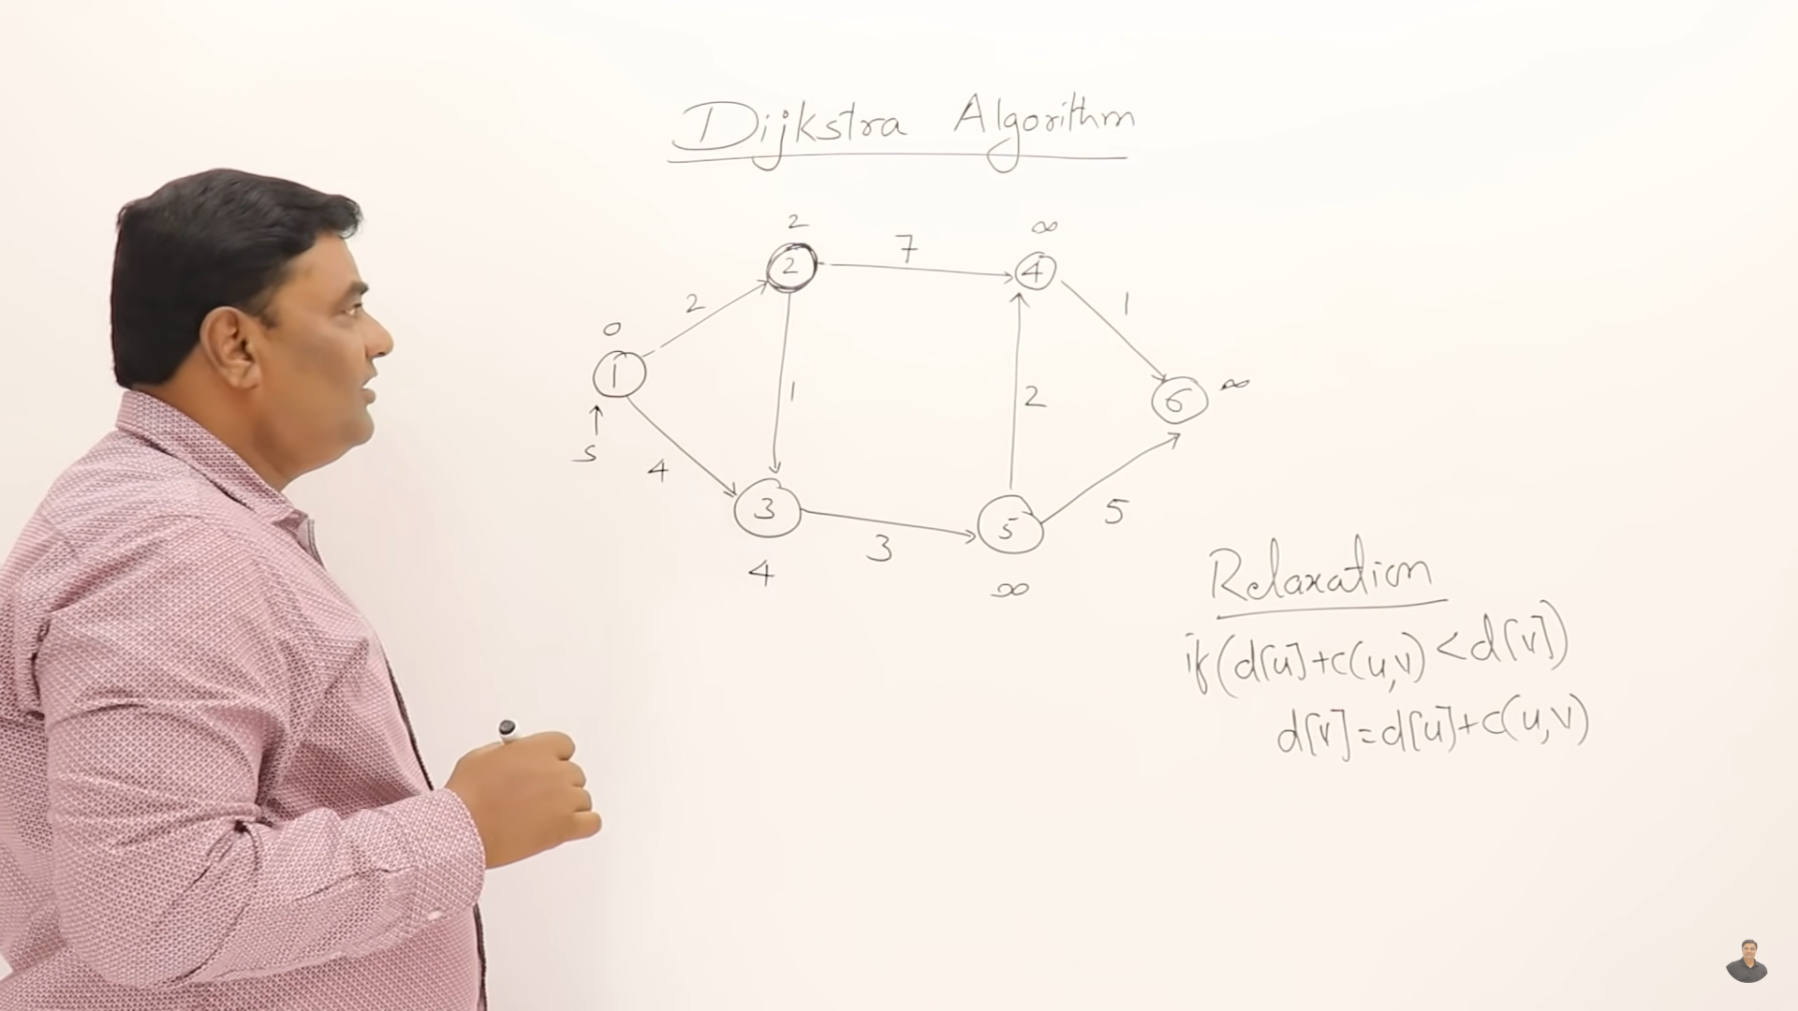
Select 2 that is min cost

Slide 9
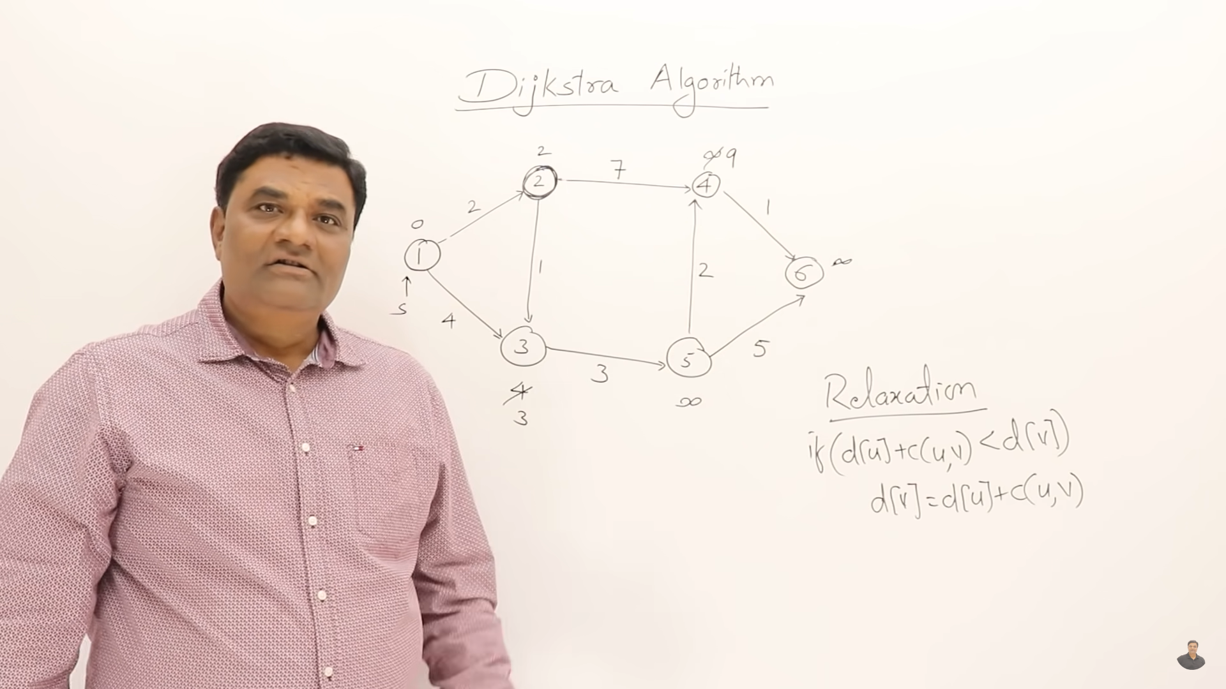
relaxation
relaxation

Slide 10
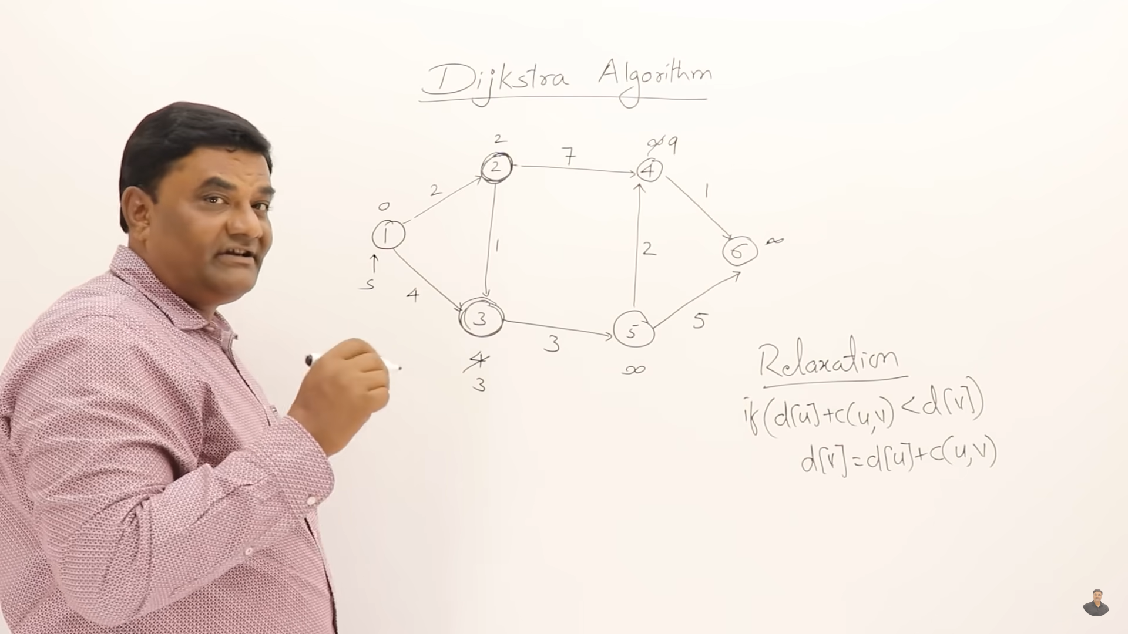
Then chost the min cost of all dis => select 3 <9 <inf

Slide 11
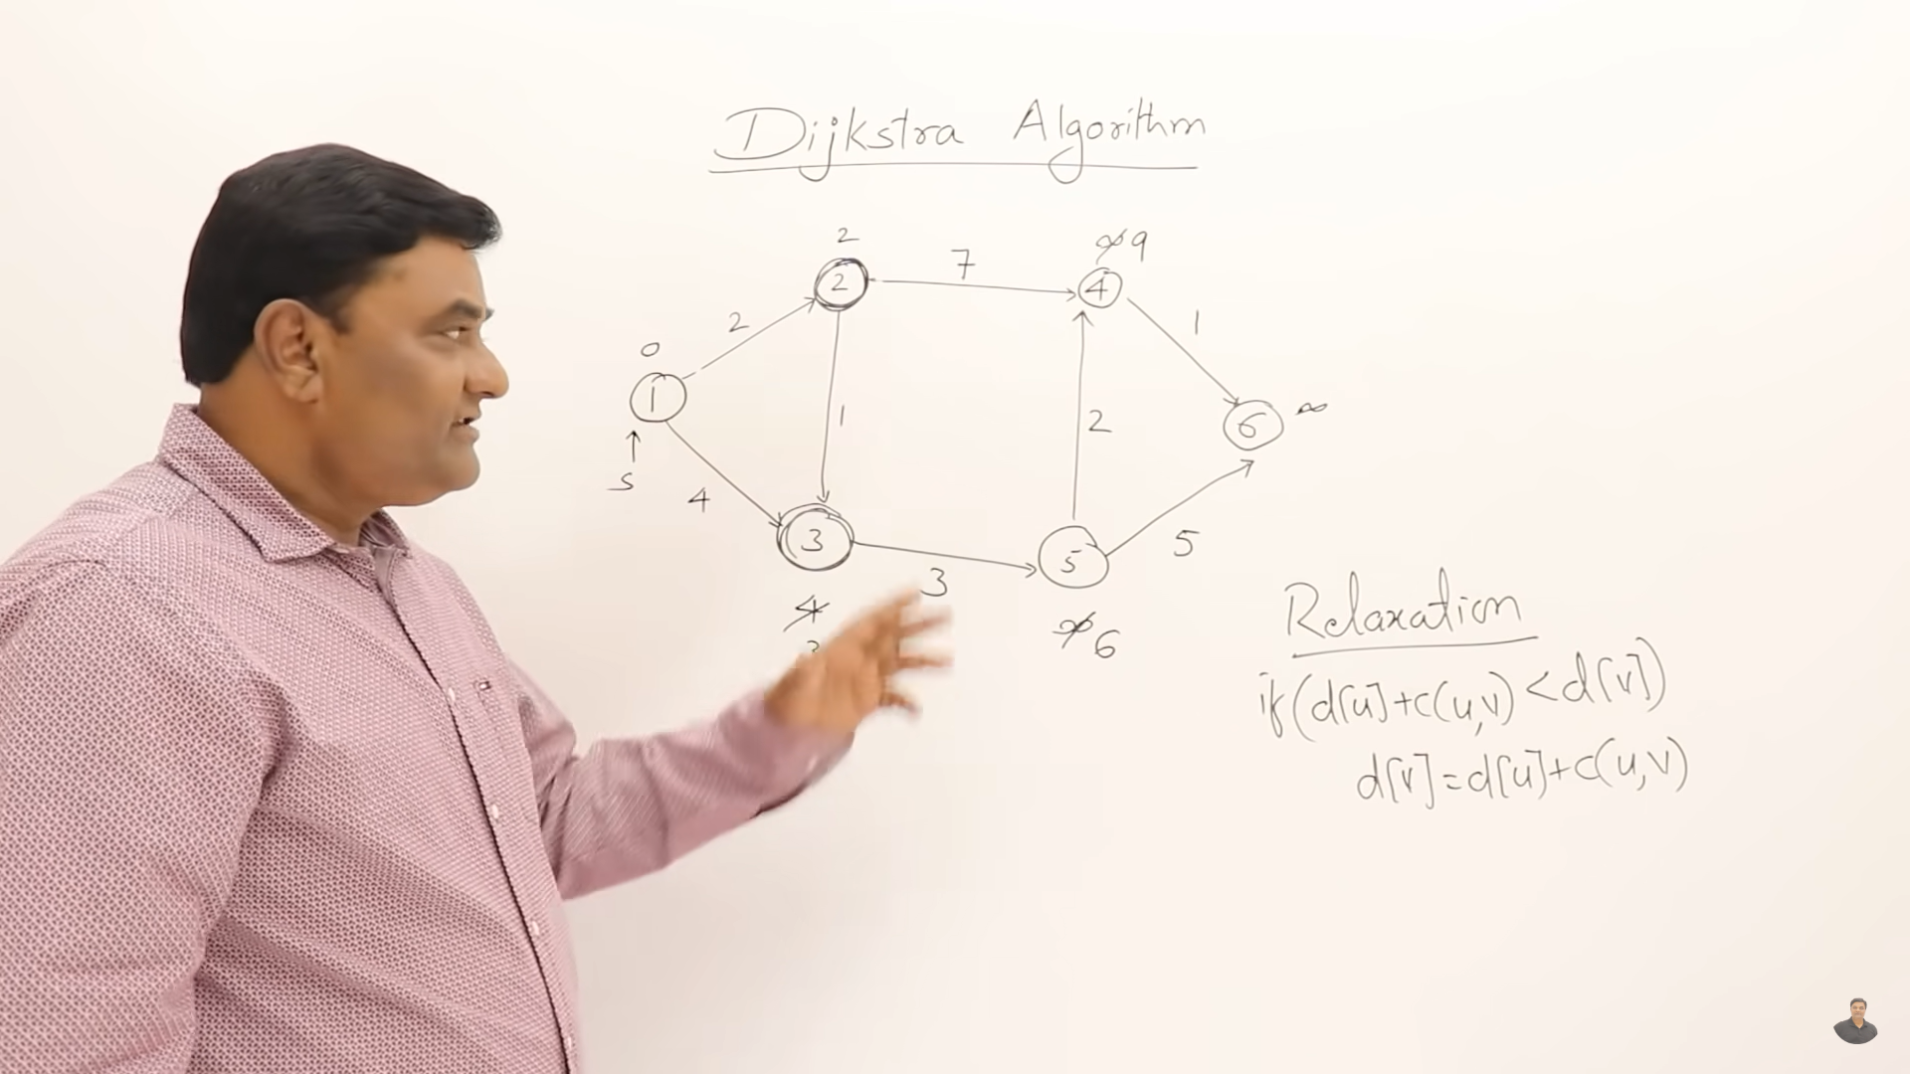
Let relaxation

Slide 12
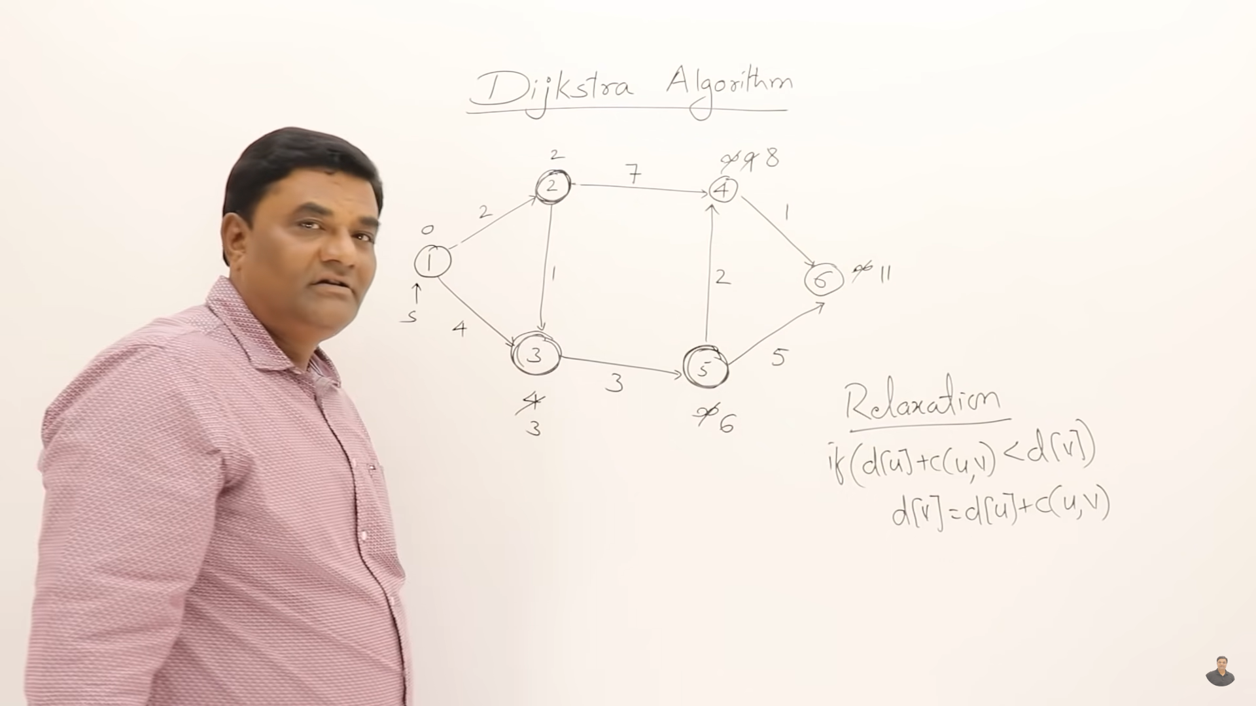
Relaxation of connected vertex

Slide 13
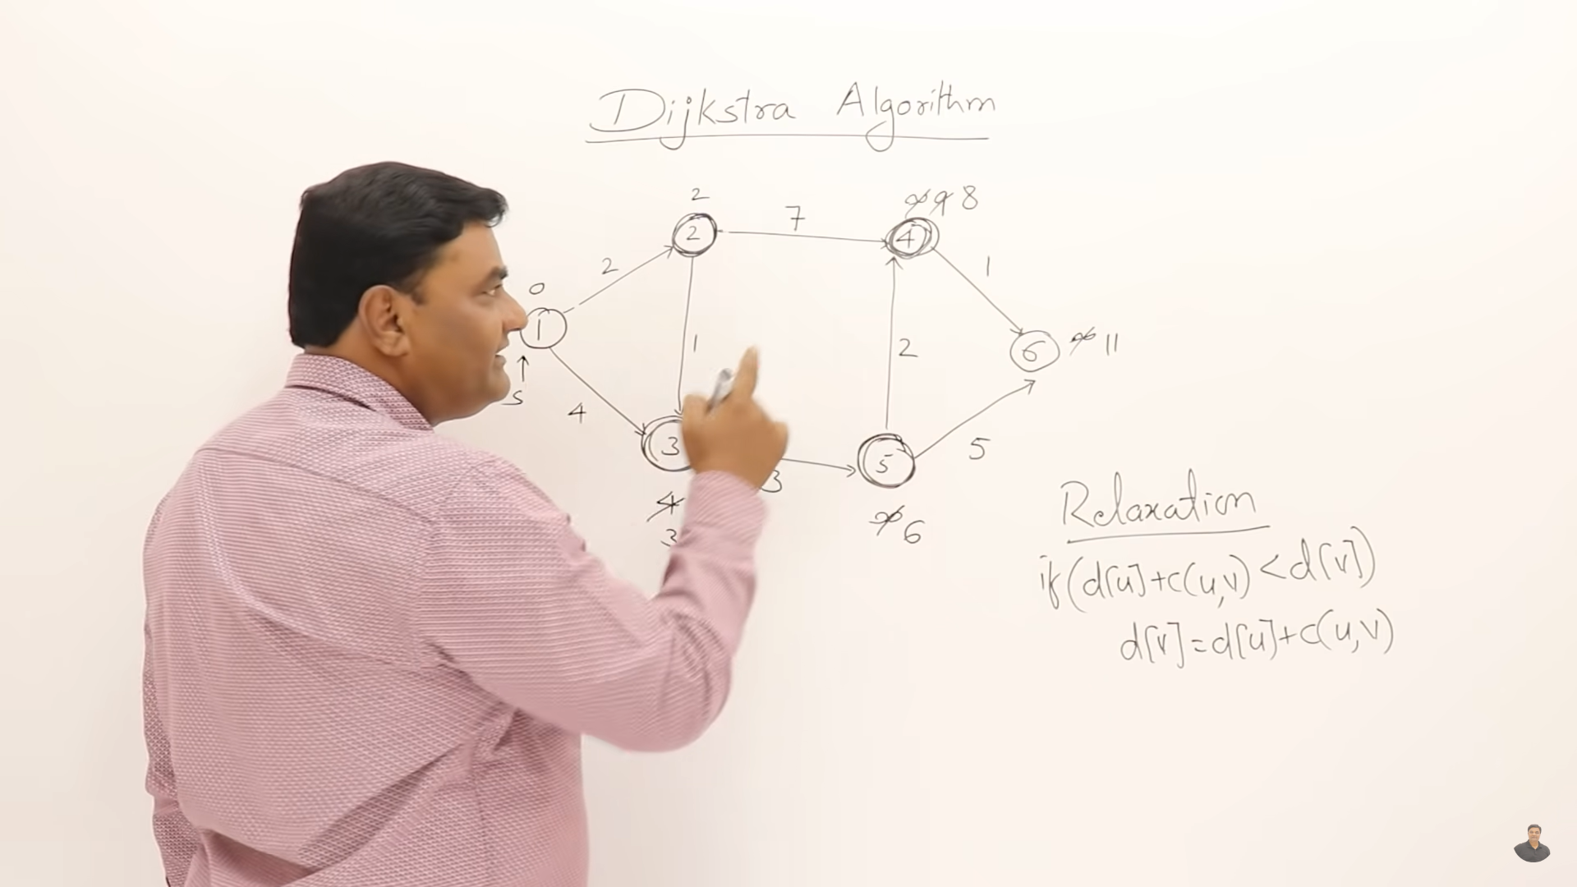
Chose min distance => 8<11

Slide 14
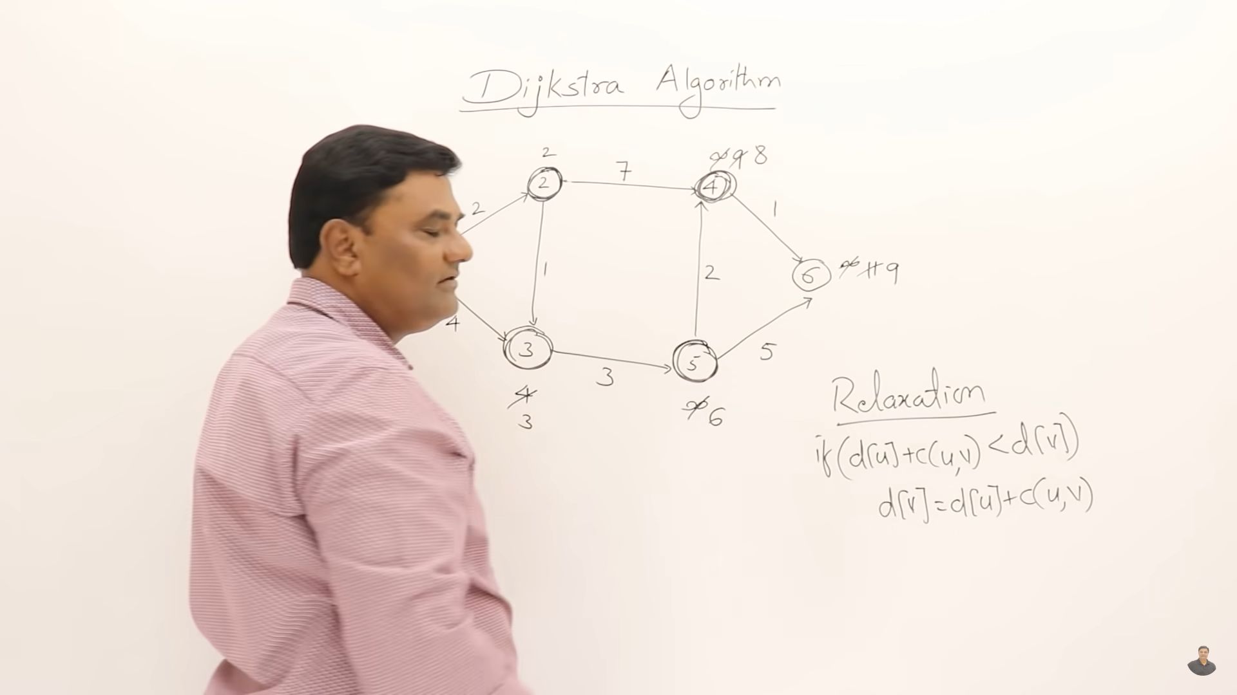
relaxation

Slide 15
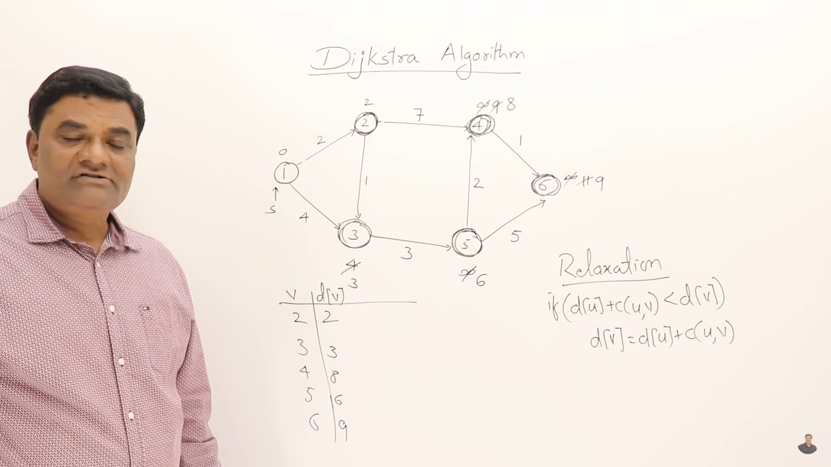
Sortest path from source

Slide 16
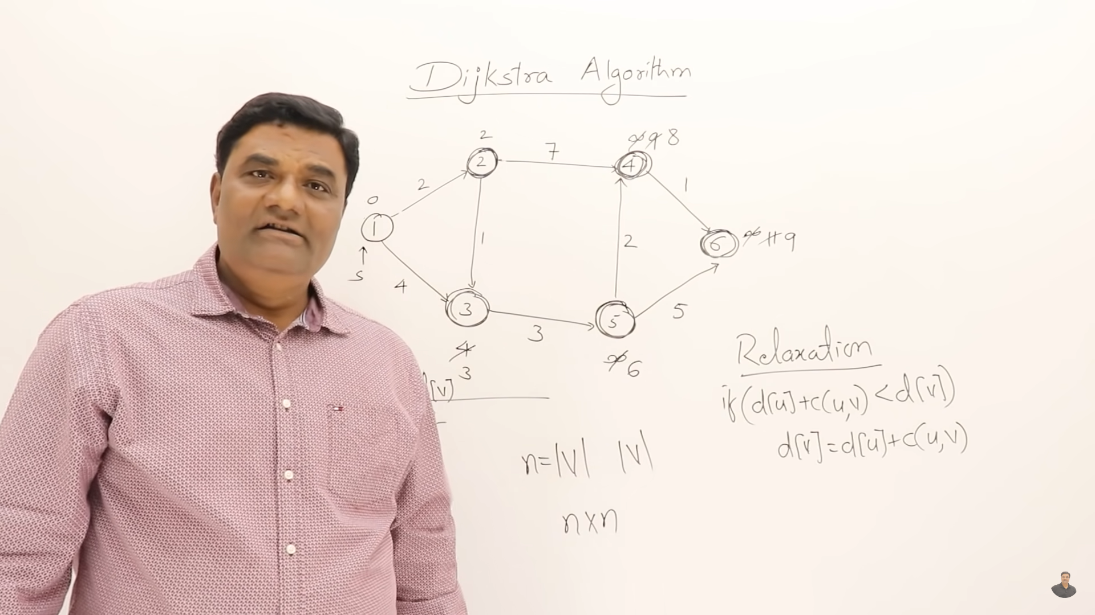
first n for every vertex,second n for each relaxation of vertex

Slide 18
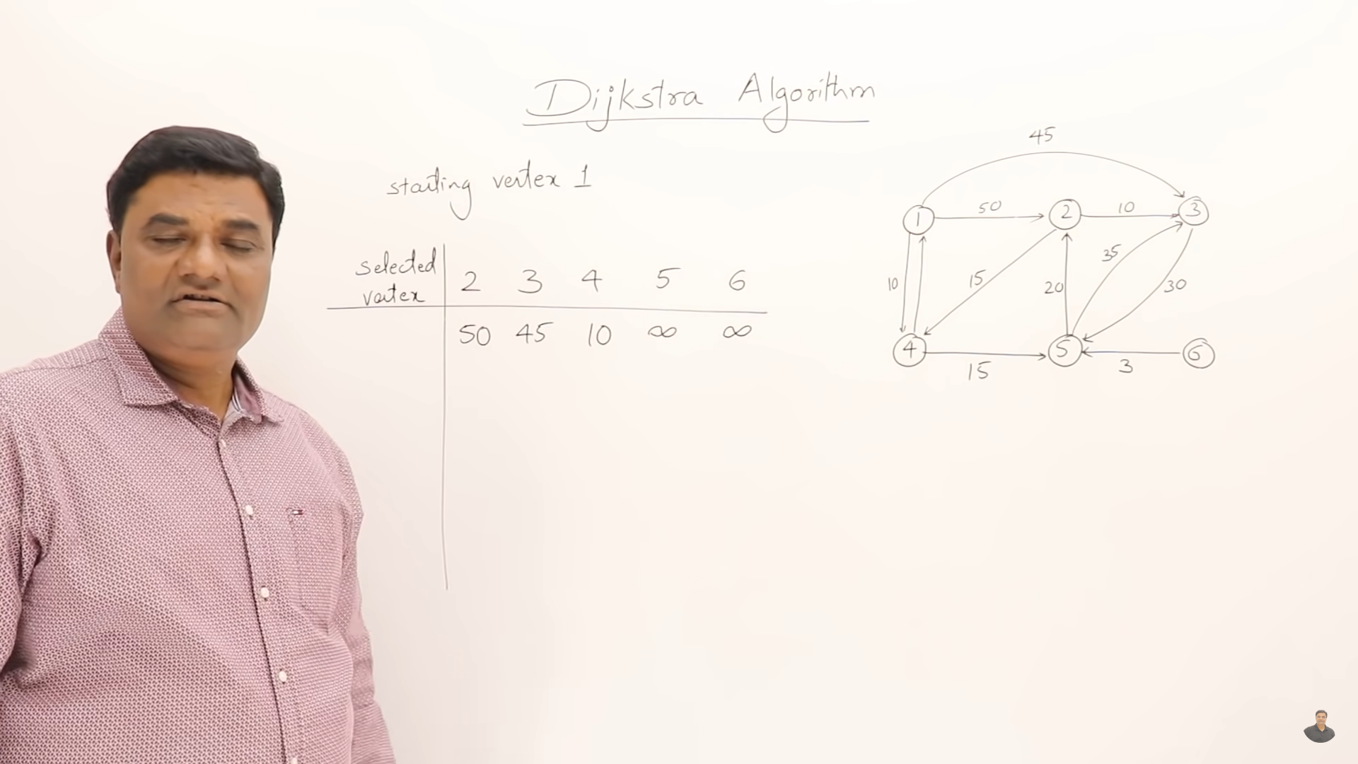
1-2 dis = 50
1-3 dis = 45
1-4 dis = 10
1-5 dis = not have edge = inf
1-6 dis = not have edge = inf

Slide 19
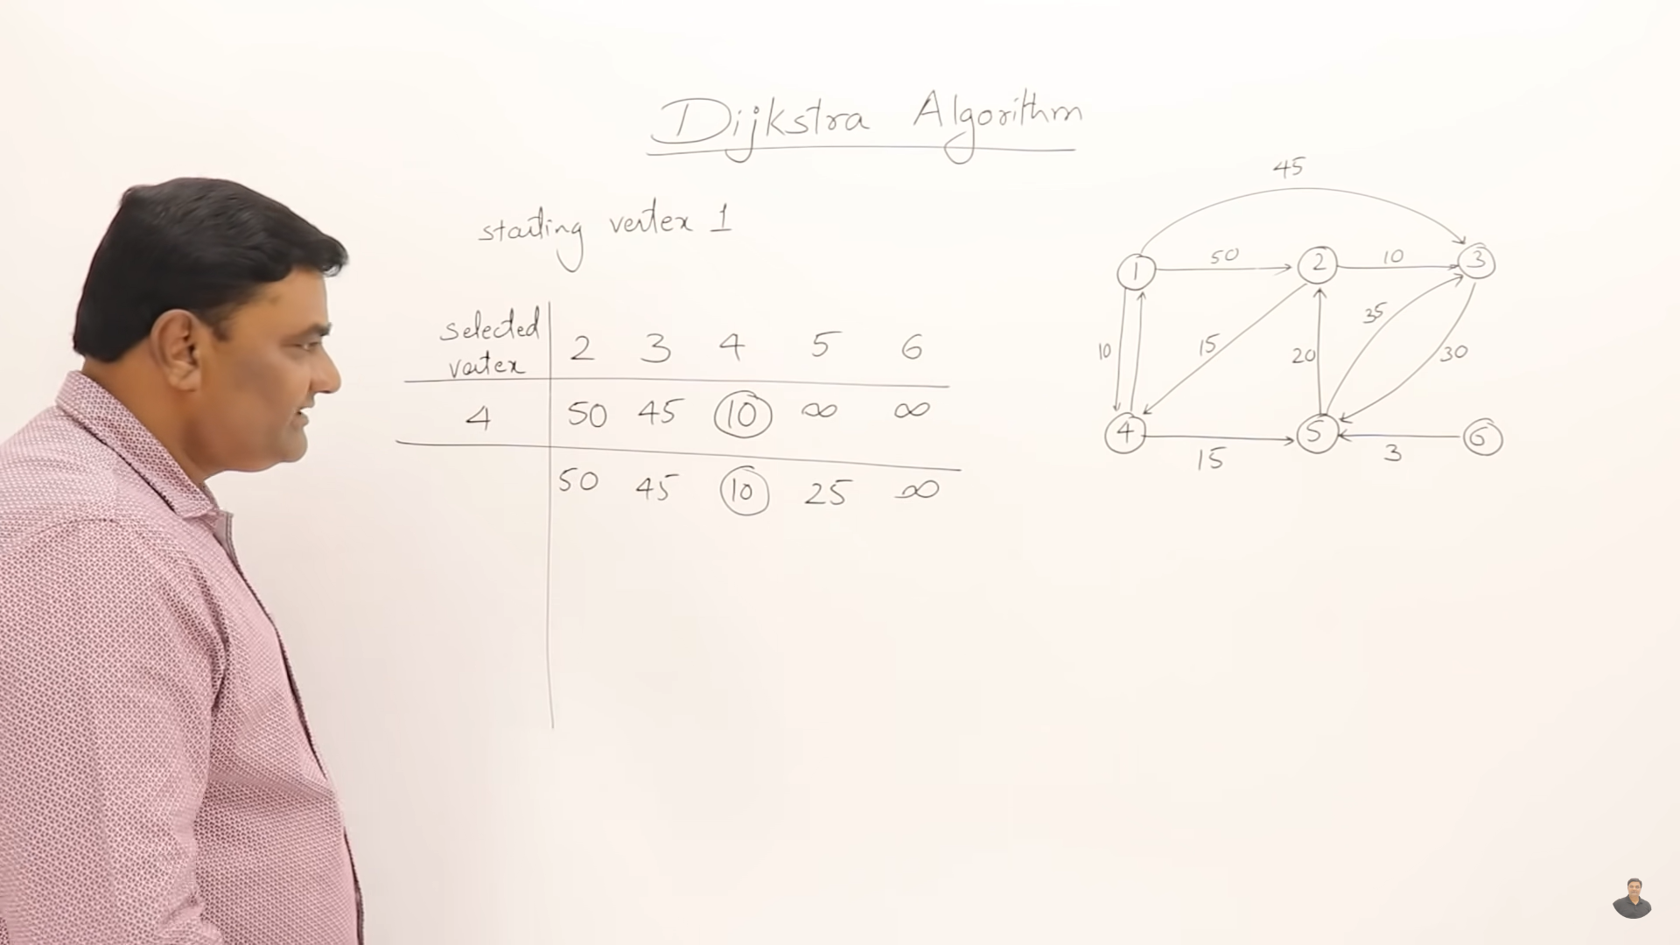
Select min dis
Relaxation of connect chosen vertex and select of min dis in array

Slide 20
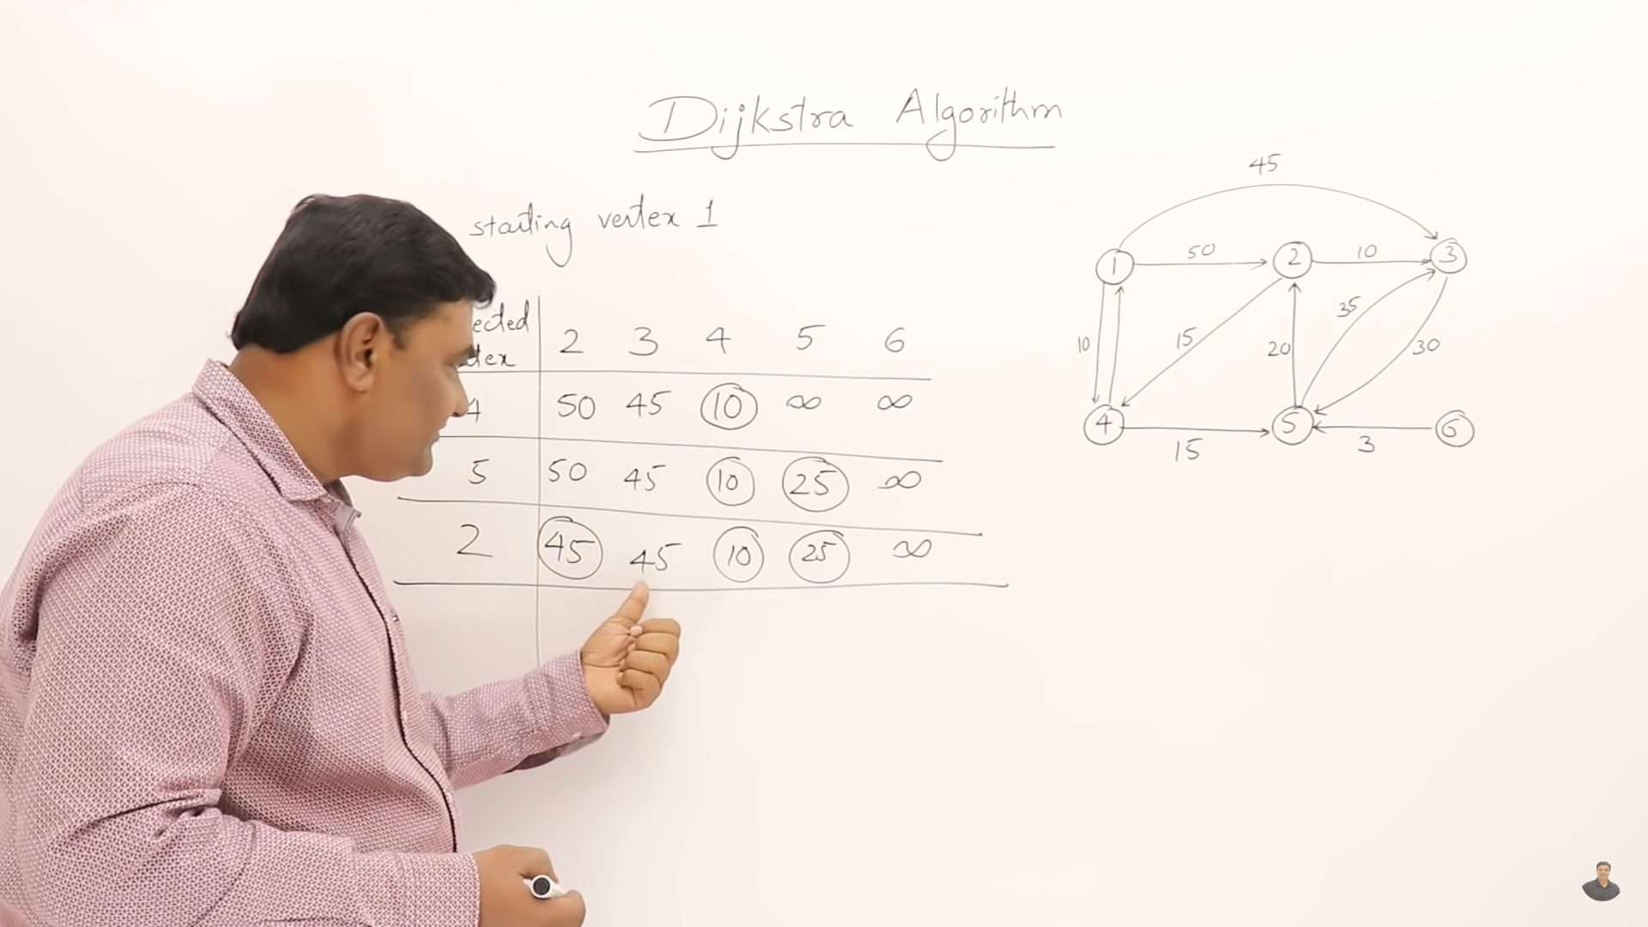
Relaxation of connect chosen vertex and select of min dis in array => 2 or 3 could be
When vertex is visted no need to relaxation

Slide 21
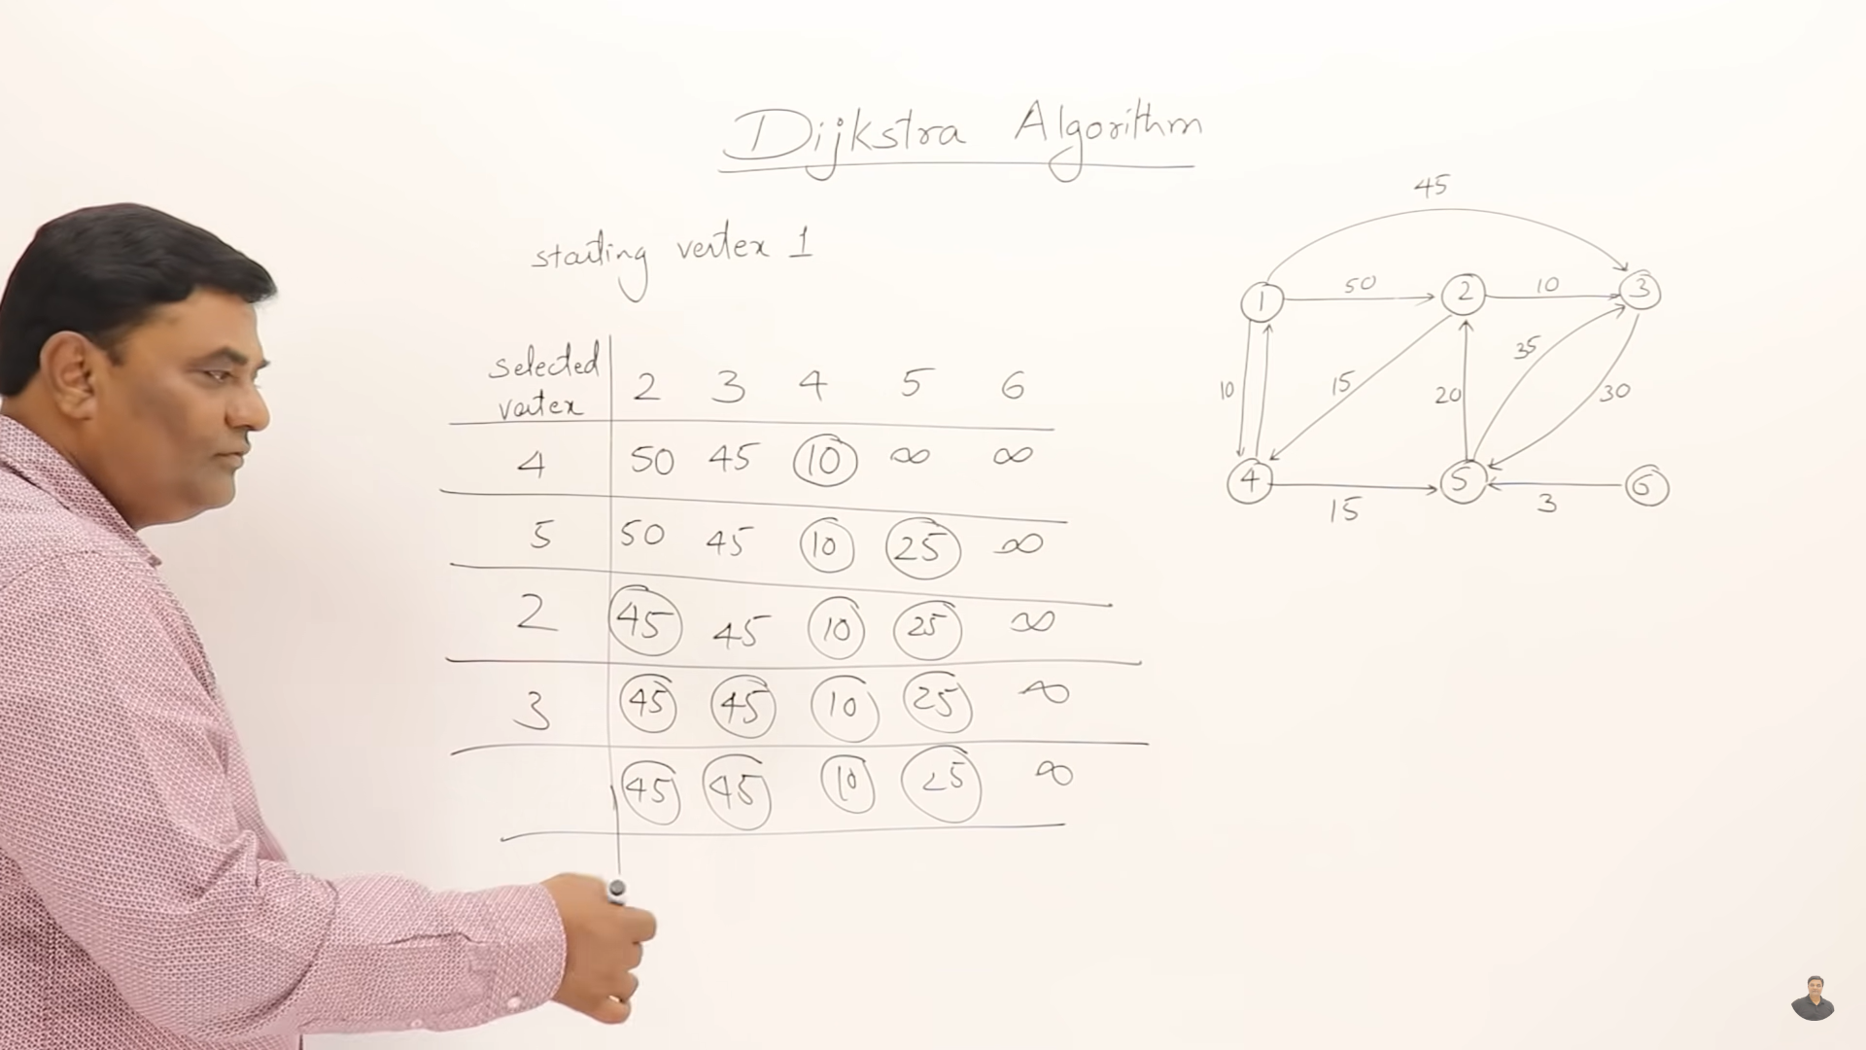

Slide 22
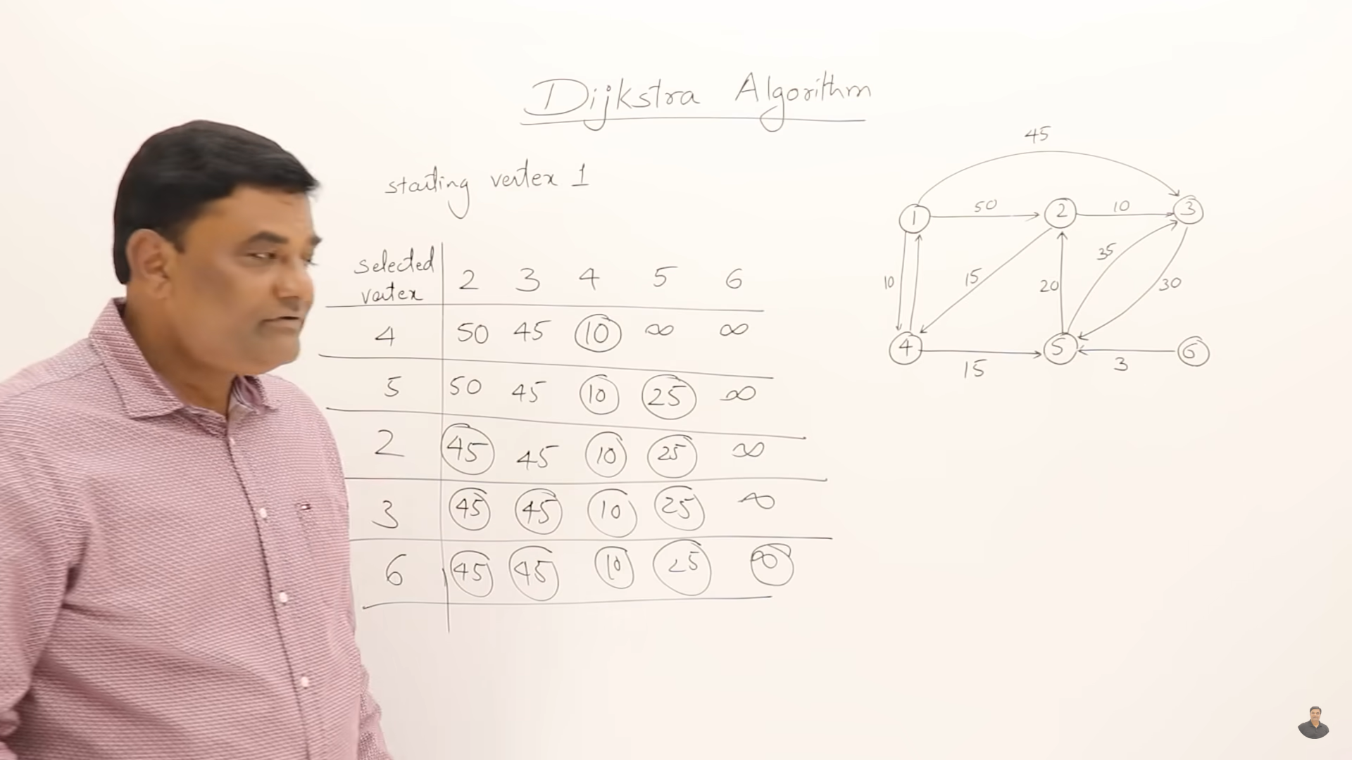

Slide 23
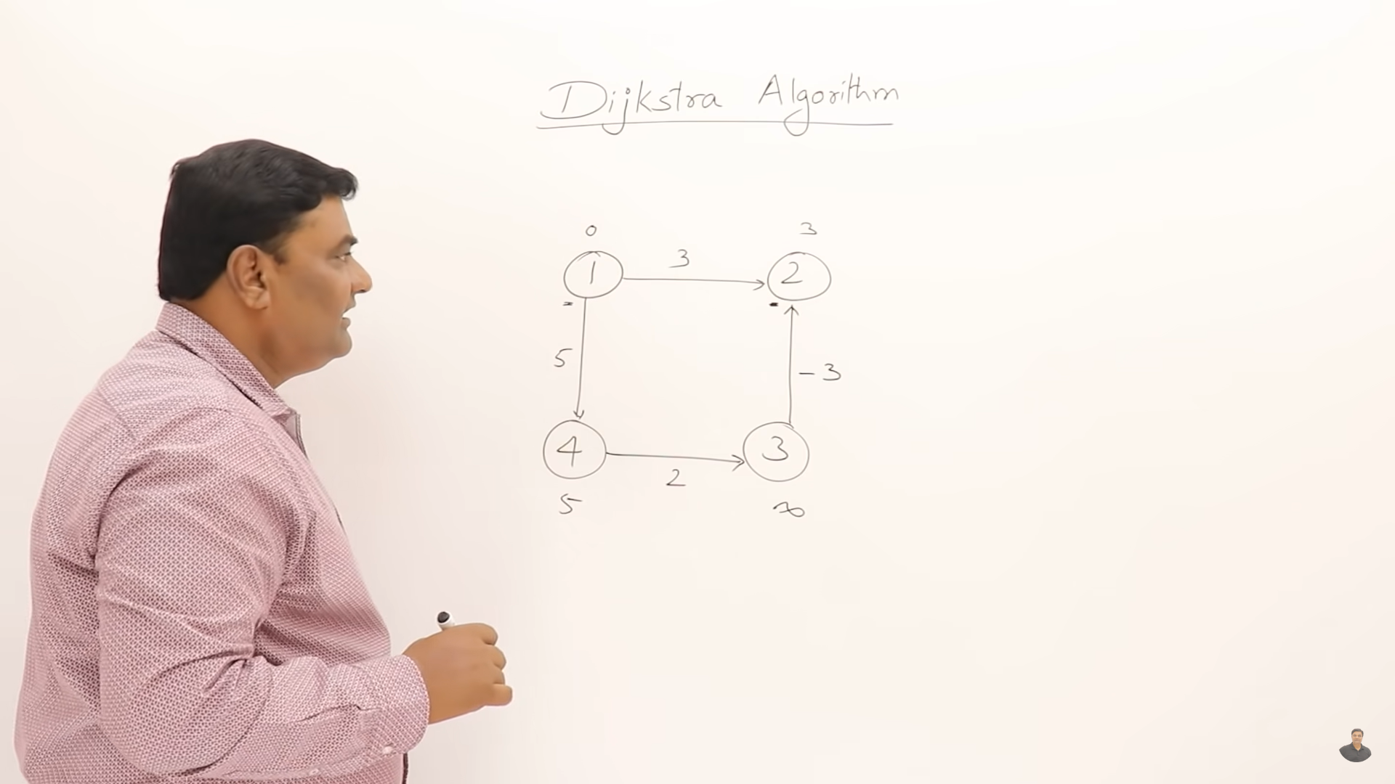



May work or may not work in djistra

Slide 24
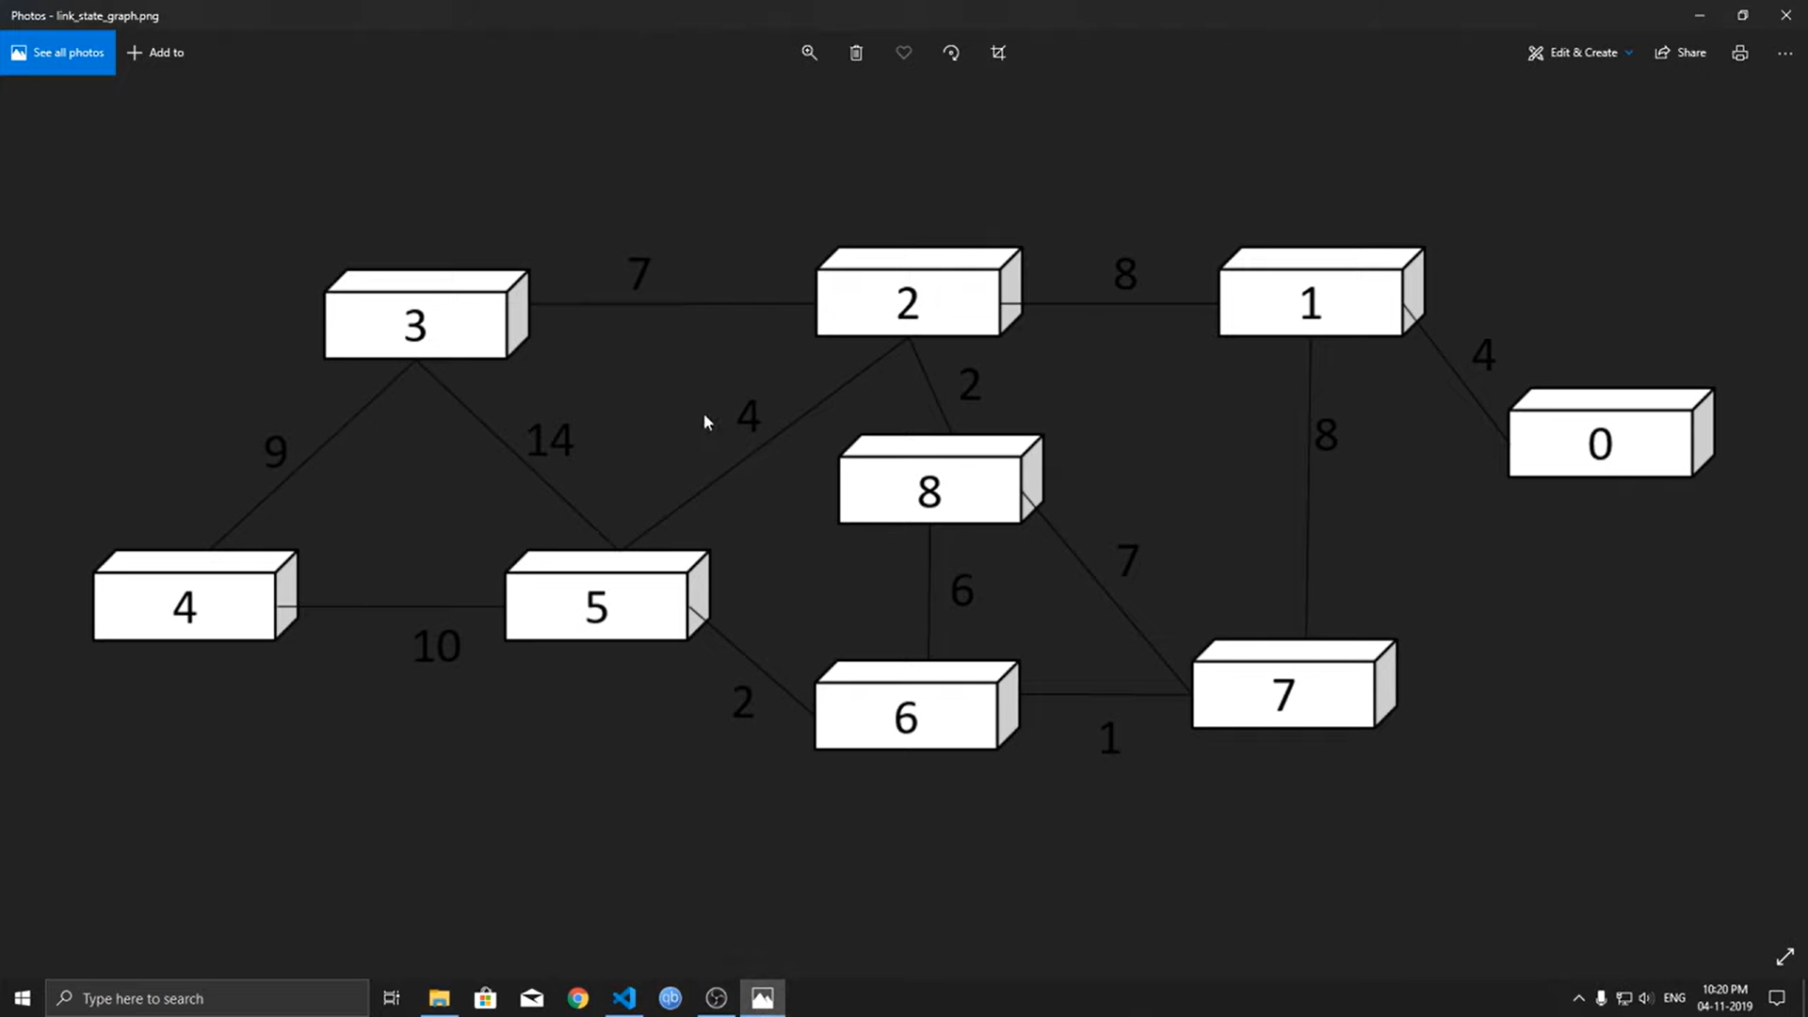

Slide 25
https://gist.github.com/nateshmbhat/1a79daa00a148e44ad79c3e338977440#file-dijkstra_algorithm-cpp (v^2)
https://ideone.com/Pmj7sa (priority queue elogn)

Slide 26
https://www.geeksforgeeks.org/dijkstras-shortest-path-algorithm-greedy-algo-7/
https://www.geeksforgeeks.org/printing-paths-dijkstras-shortest-path-algorithm/

Slide 27
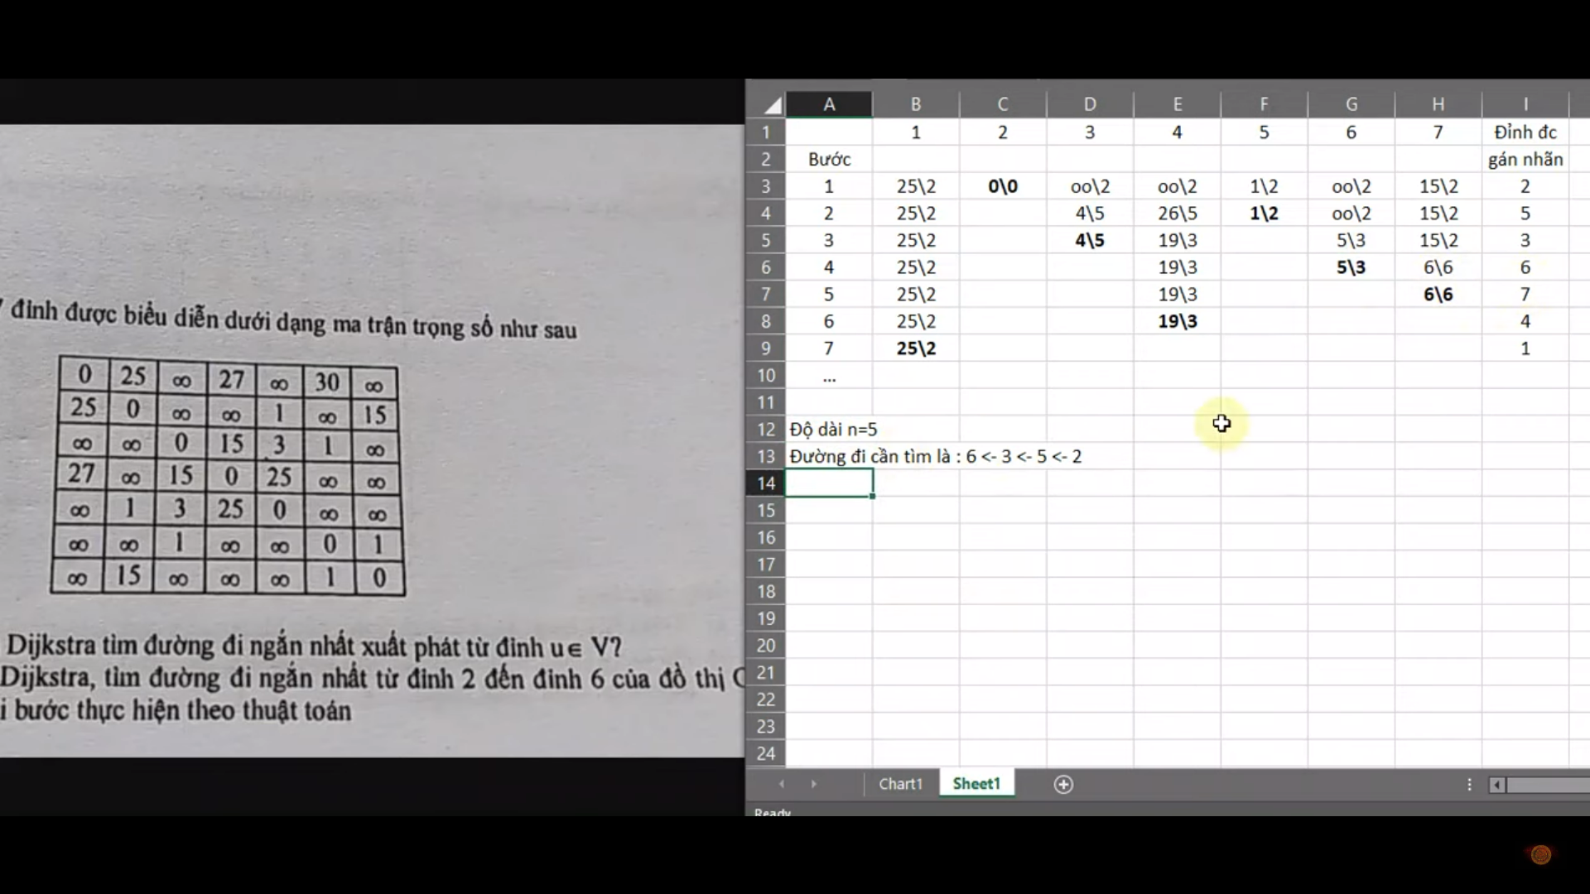
Khoang cach/tu
Djitra positive dis

Slide 28
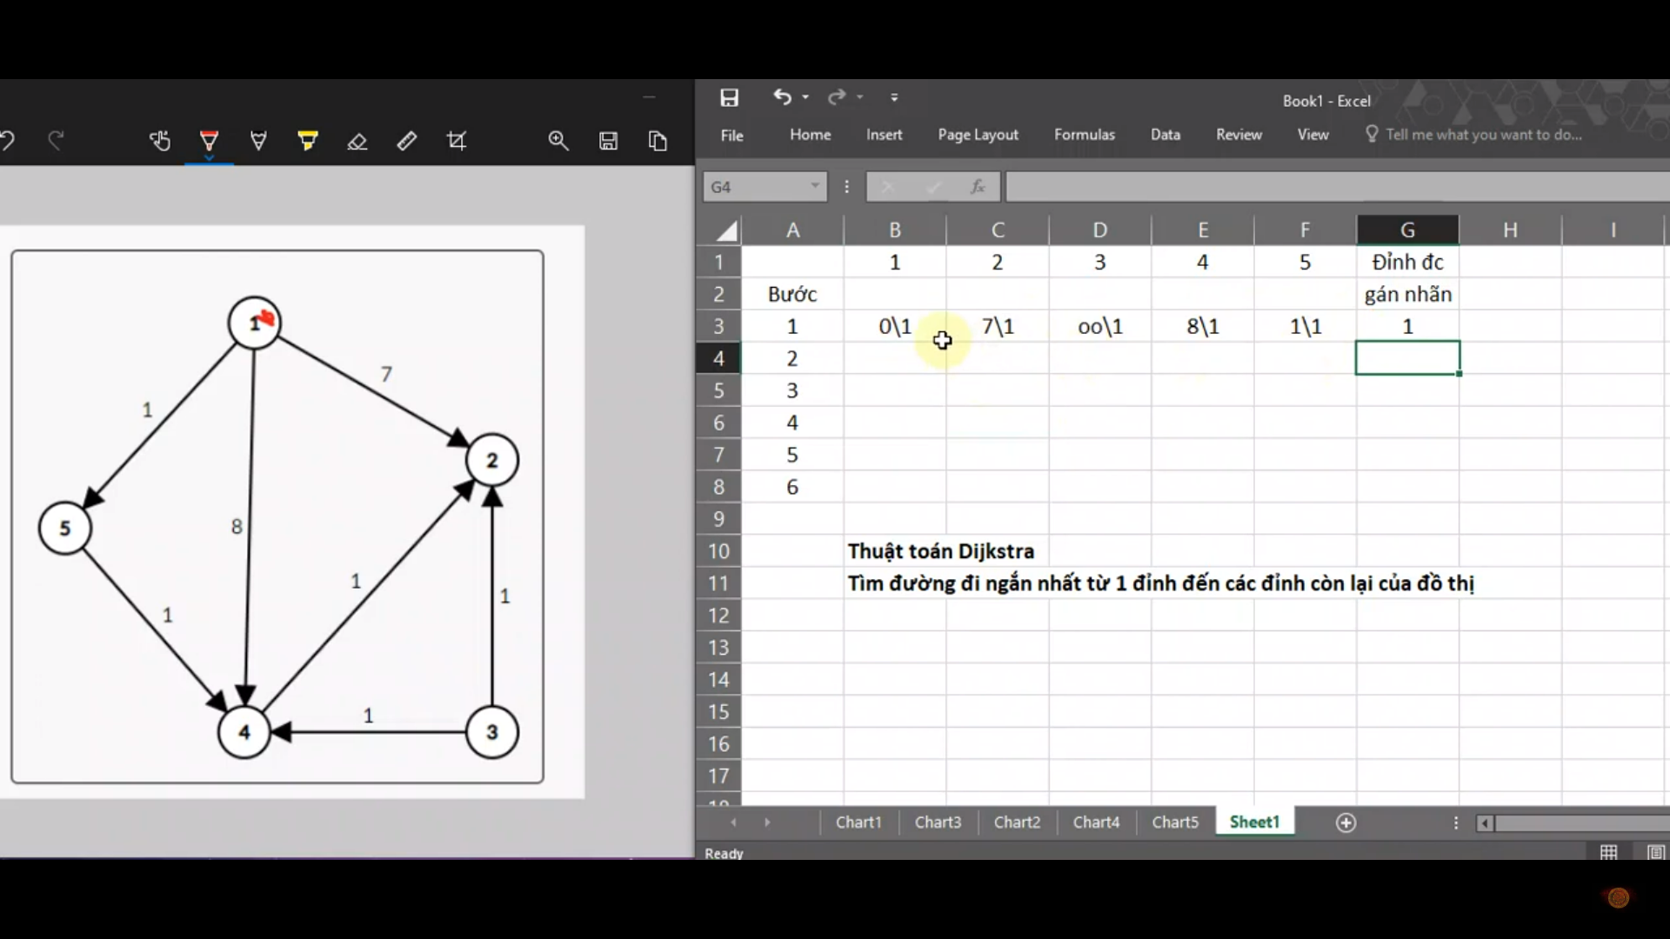

Slide 29
